Slide 1

TED TALK
Popularity Analysis
LANGXIN LI, QI SUN, YANGXINYUE WANG, DERRICK LI

Slide 2
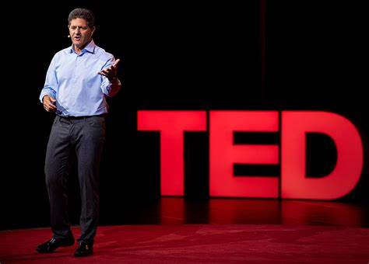
Research Context
What factors predict the popularity of TED Talks?
duration?
topics?
number of languages?
publish date?
or others ...... ?

Slide 3
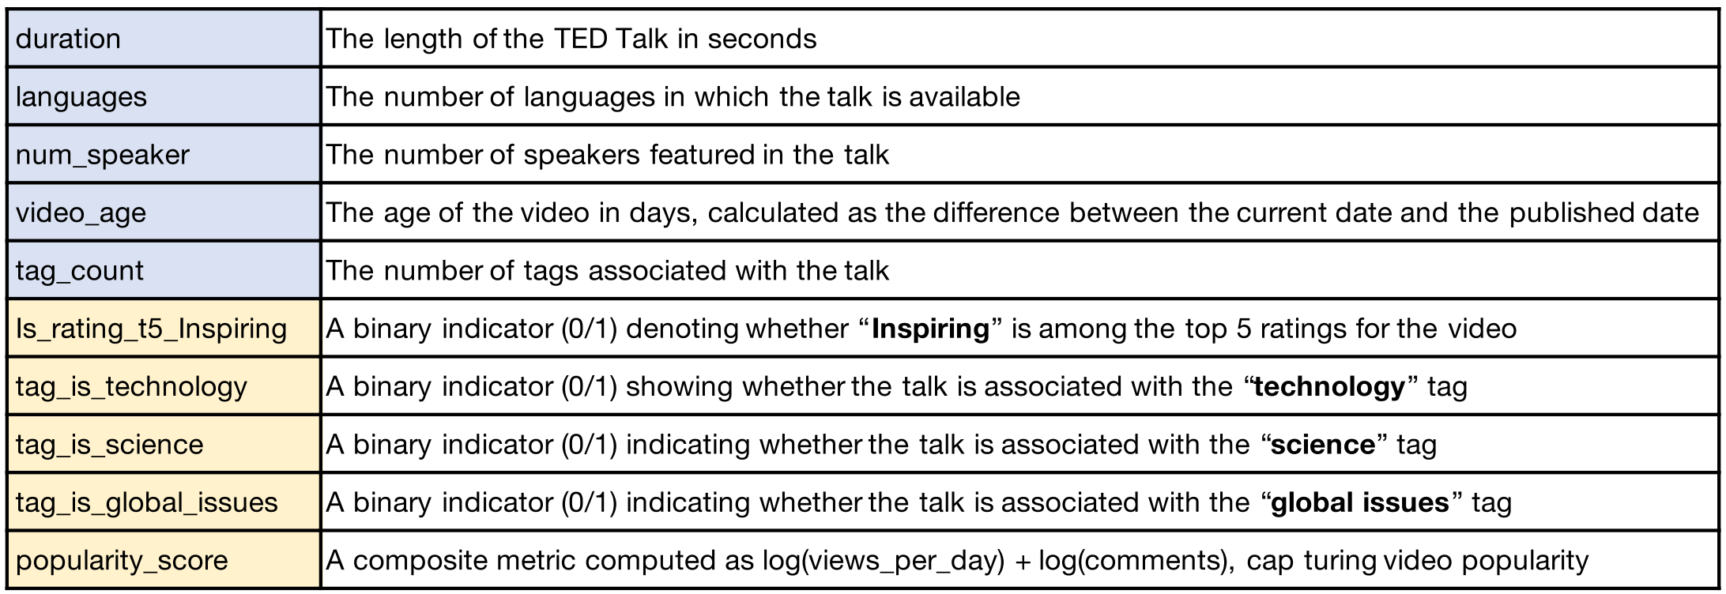
Summary of variables

Slide 4
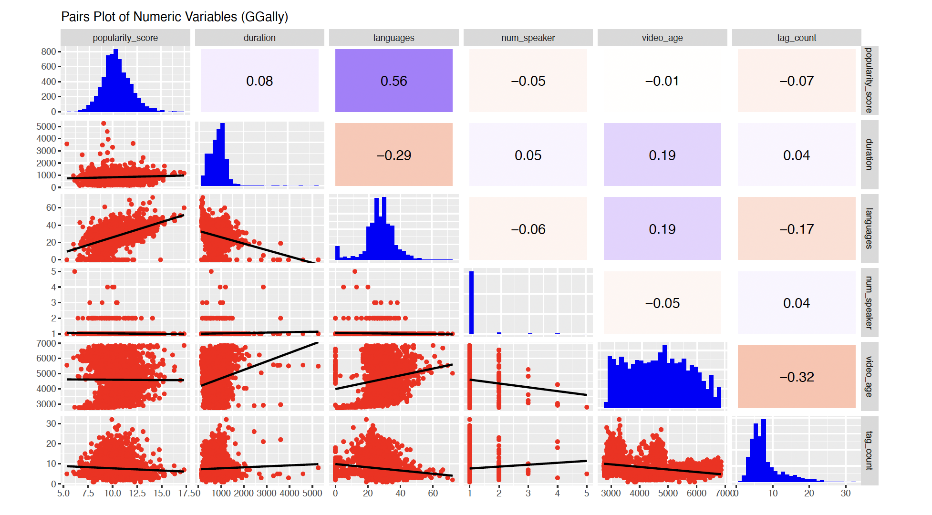
Variable Correlation Analysis

Slide 5
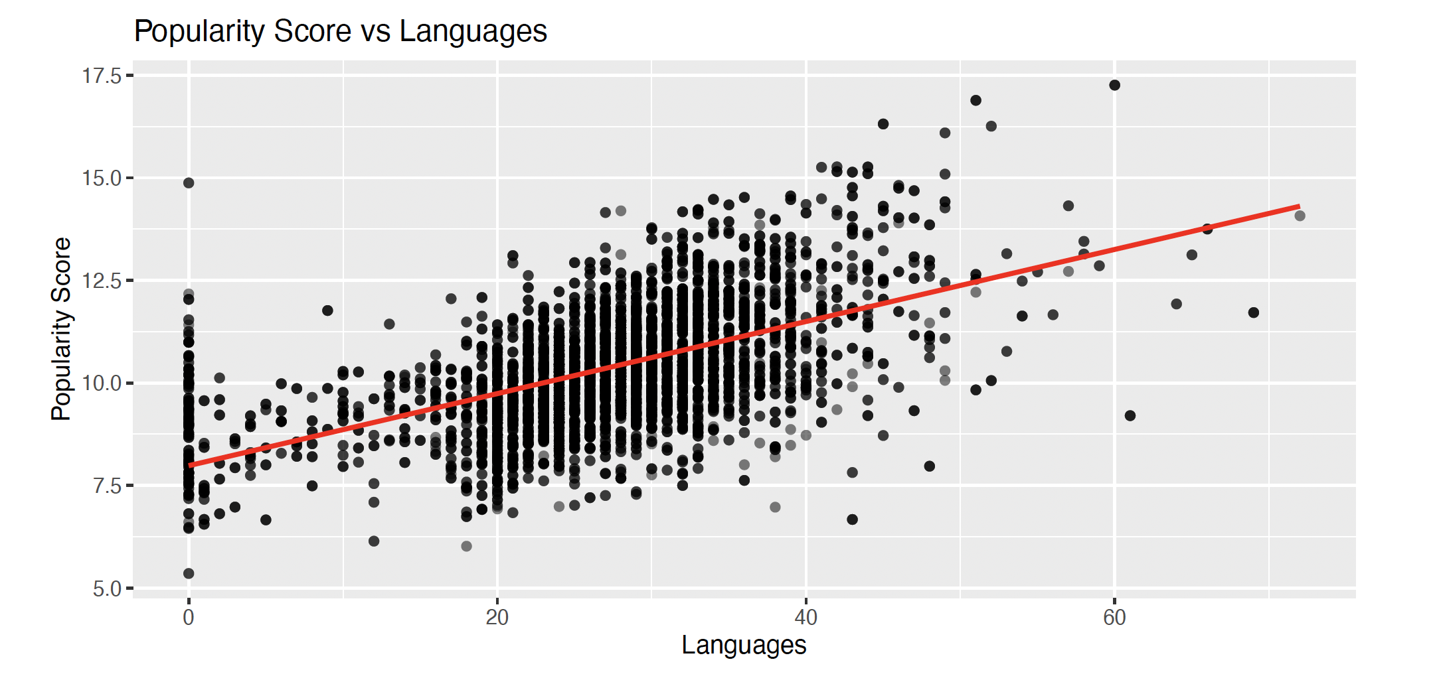
Popularity Score vs Languages

Slide 6
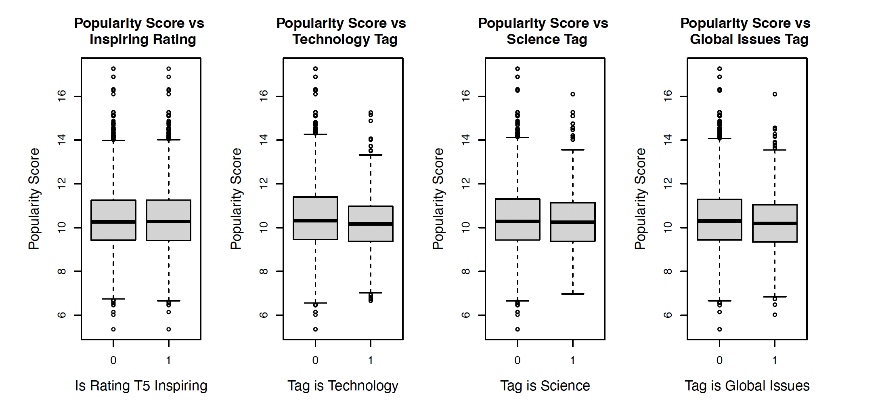
Popularity Score vs Tags and Ratings

Slide 7
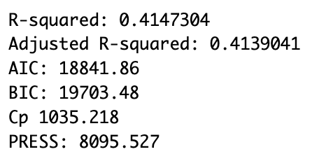
Main Effect Model

Slide 8
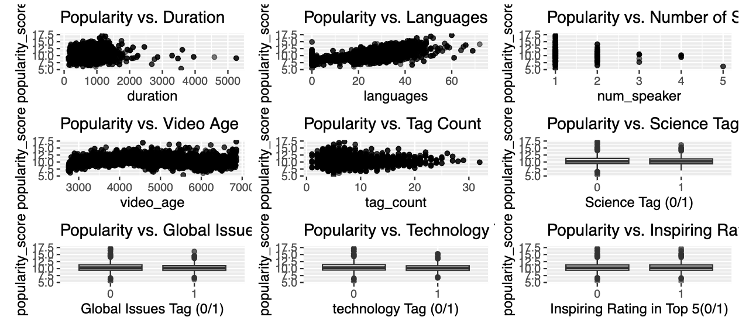
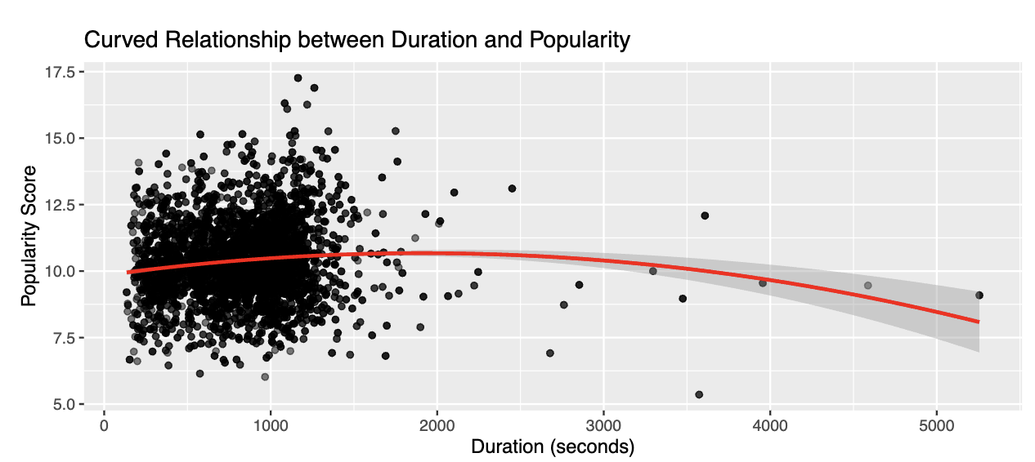
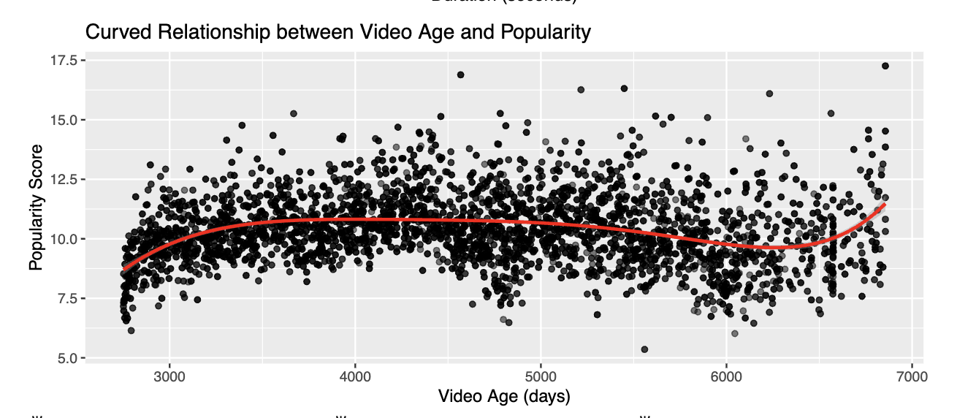
Check for Linearity & Curvature

Slide 9
Interaction Terms
Based on domain knowledge, add interaction between
Duration and languages
Video age and languages
Number of speaker and languages
Full model:
How k and n are defined?

Slide 10
Polynomial Terms
Full model:​
(k, n) | (2,2) | (3,2)
R² | 0.468 | 0.4707
R²adj | 0.467 | 0.4692
AIC | 19149.95 | 19149.95
BIC | 19149.95 | 19140.5
PRESS | 7378.552 | 7347.228
(k, n) | (2,2) | (2,3) | …(2,5) | (2,6) | (2, 7)
R² | 0.468 | 0.480 | 0.4904 | 0.497 | 0.497
R²adj | 0.467 | 0.479 | 0.489 | 0.495 | 0.495
AIC | 19149.95 | 19140.5 | 19022.73 | 18933.34 | 18867.7
BIC | 19149.95 | 19022.73 | 18933.34 | 18867.7 | 18881
PRESS | 7378.552 | 7218.66 | 7092.572 | 7004.898 | 7006.914

Slide 11
Full Model
Full model:​
R² | 0.497
R²adj | 0.495
Cp | 25
AIC | 18933.34
BIC | 18867.7
PRESS | 7004.898

Slide 12
Stepwise Regression based on AIC:
 | Step 1 | Step 2 | Step 3
poly(duration, 2) | - | - | -
languages | - | - | -
num_speaker | - | - | -
poly(video_age, 6) | - | - | -
tag_count | - | - | -
Is_rating_t5_Inspiring | NA | NA | NA
tag_is_technology | - | NA | NA
tag_is_science | - | - | -
tag_is_global_issues | - | - | -
poly(duration, 2):languages | - | - | -
poly(video_age, 6):languages | - | - | -
num_speaker:languages | - | - | NA

Slide 13
Stepwise Regression based on AIC:
 | ΔR² | ΔR²adj | ΔCp | ΔAIC | ΔBIC | ΔPRESS
Step 0 | 0.4970105 | 0.4951121 | 25 | 18691.9 | 18867.7 | 7004.898
Step 1 | 0.4970027 | 0.4951837 | 23.09851 | 18690 | 18859.04 | 7002.771
Step 2 | 0.496992 | 0.4952523 | 21.23452 | 18688.14 | 18850.42 | 7000.736
Step 3 | 0.4969756 | 0.4953152 | 19.441 | 18686.35 | 18841.86 | 6997.4
Adjusted R Squared Increases
AIC, BIC, PRESS, Cp Decreases

Slide 14
Step-AIC model
 | Main Effect Model | Full Model | Step AIC Model
R_squared | 0.4147304 | 0.4970105 | 0.4969756
Adjusted_R_squared | 0.4139041 | 0.4951121 | 0.4953152
Mallows’ Cp | 1035.218 | 25 | 19.441
AIC | 18841.86 | 18691.9 | 18686.35
BIC | 19703.48 | 18867.7 | 18841.86
PRESS | 8095.527 | 7004.898 | 6997.4
Prediction power increased from 0.4139041 to 0.4953152

Slide 15
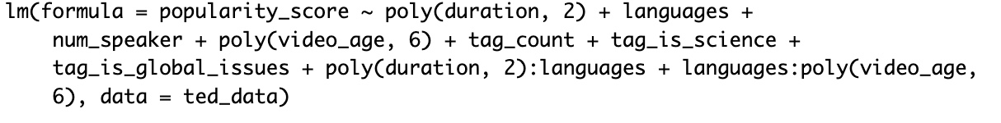

Aic final model

Slide 16
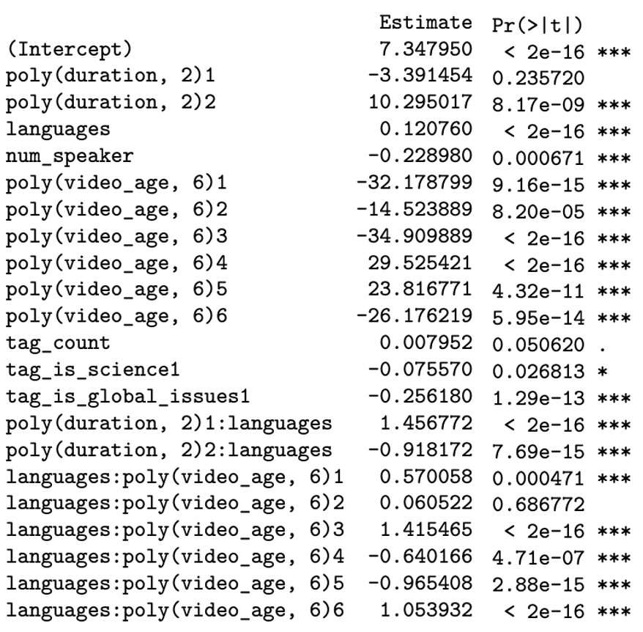
Aic final model

Slide 17
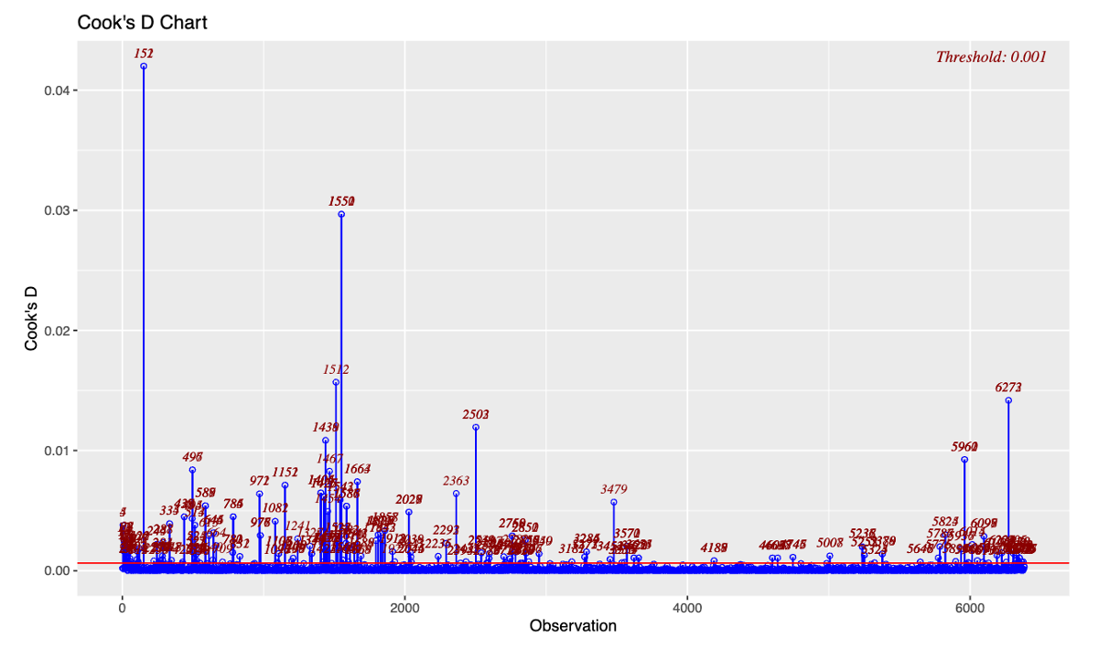
Model Diagnostics

Slide 18
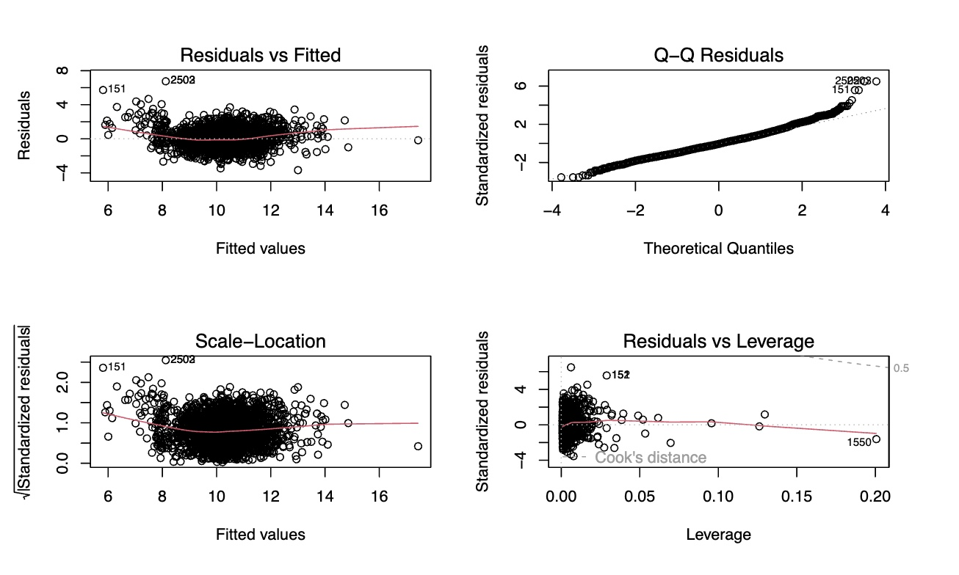
Line assumptions check

Slide 19

Data Validation
RMSE | 1.038
MAE | 0.823
R-squared | 0.52
MSPR | 1.077
MSE_F | 1.089

Slide 20
conclusion
impact
Limitations
future
Only 49.7% prediction power
Languages: 0.12
Num of speakers: -0.22
Duration: strong nonlinear effect, rather than “longer is better”.
Video age: complex, nonlinear, but fluctuates
Model choice vs. data type
Some potential variables
LINE assumptions could be improved by using WLS (51.15% prediction power)
Expand the data dimensions
Alternative Popularity Metrics
Advanced Modeling Techniques
…

Slide 21
Thank you

Slide 22
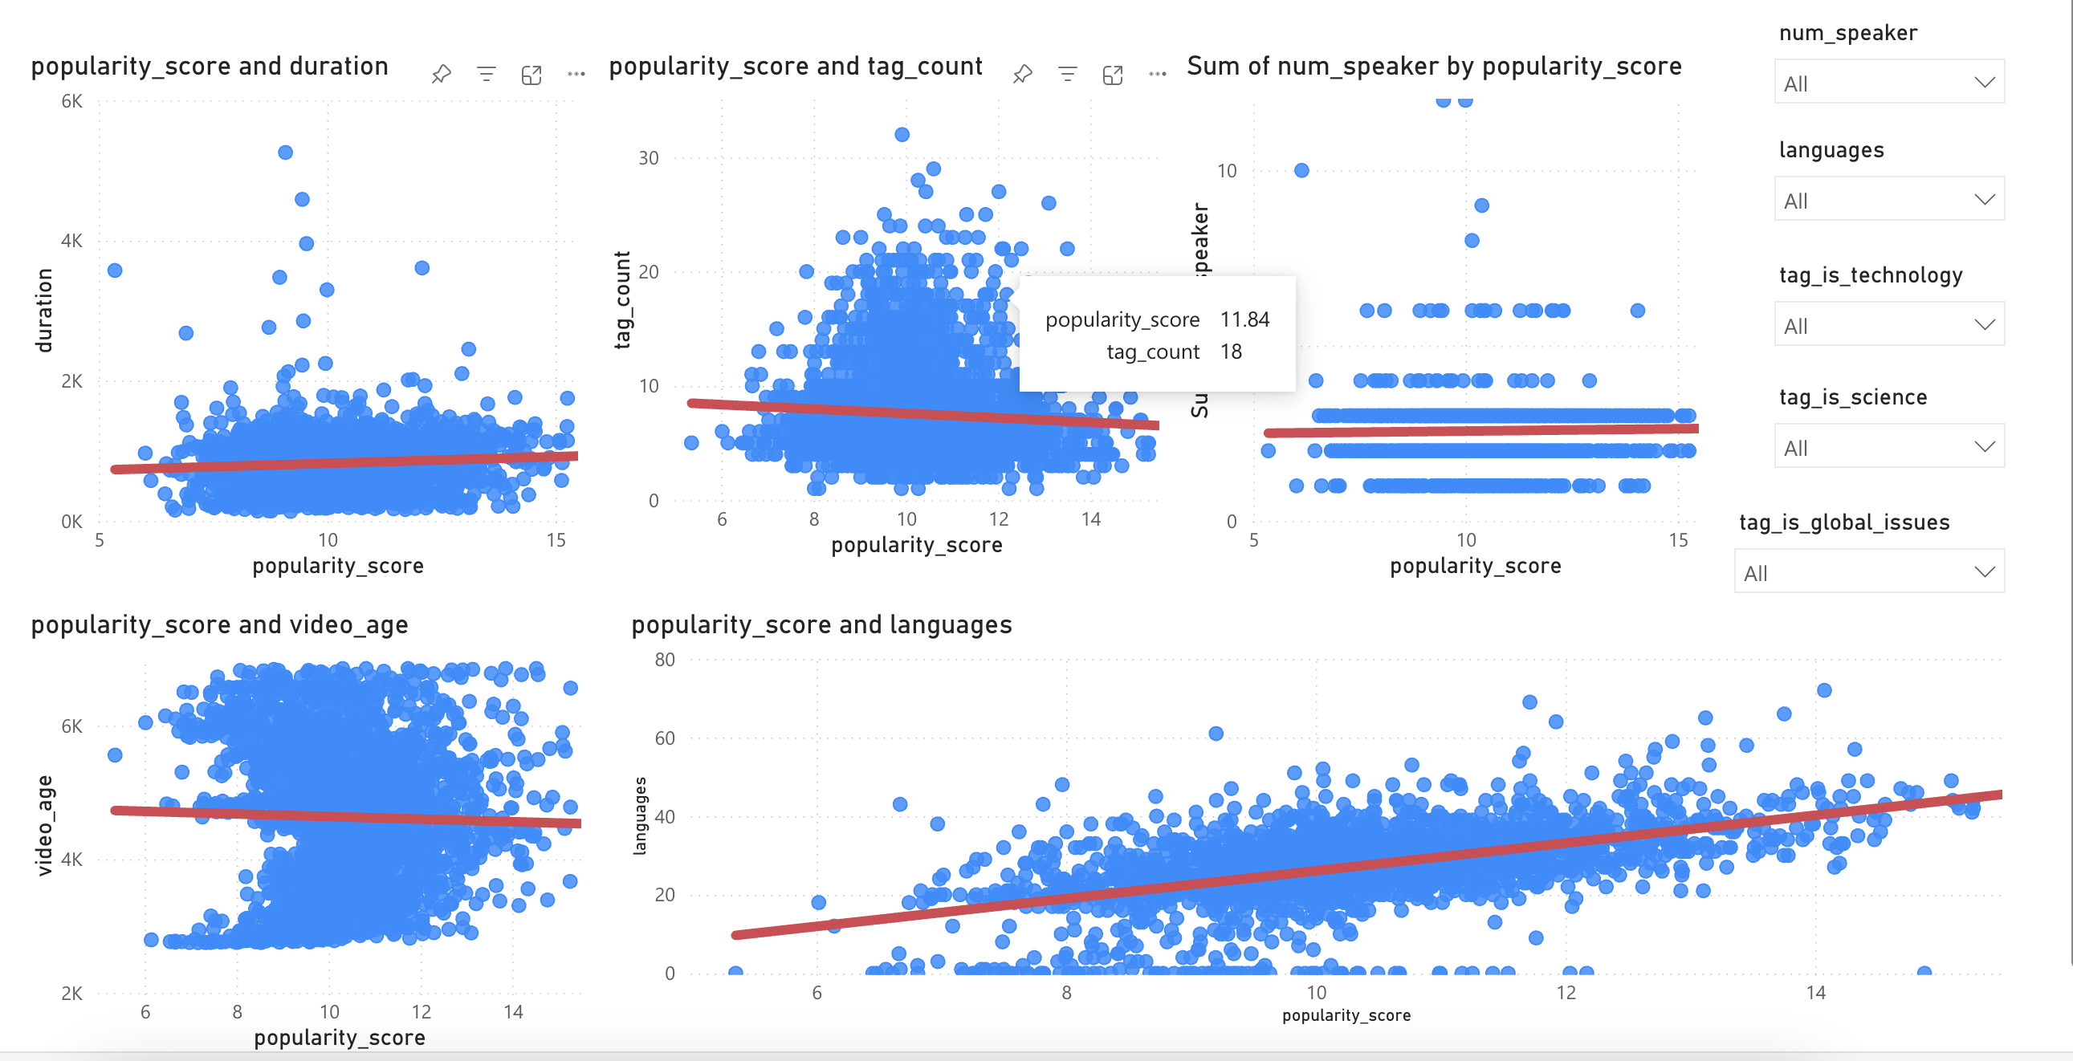
POWER bi

Slide 23
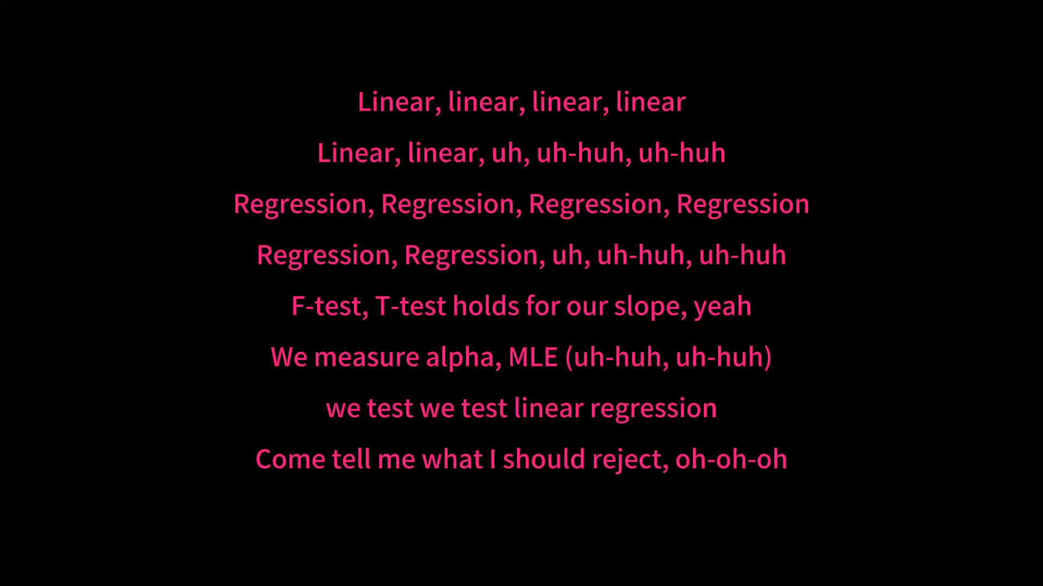
Linear. GROUP SHOW

